Slide 1
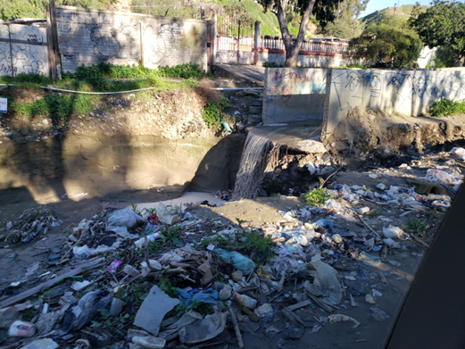




Stochastic Enviro-Financial Modelling Strategies for Sustainable Solutions to US/Mexico Cross-Border Sediment Pollution
Matthew Brand
Assistant Professor of Coastal Engineering
Department of Civil and Environmental Engineering
Louisiana State University
mbrand@lsu.edu
Notes:
Introduce myself
Thank funders and partners

Slide 2
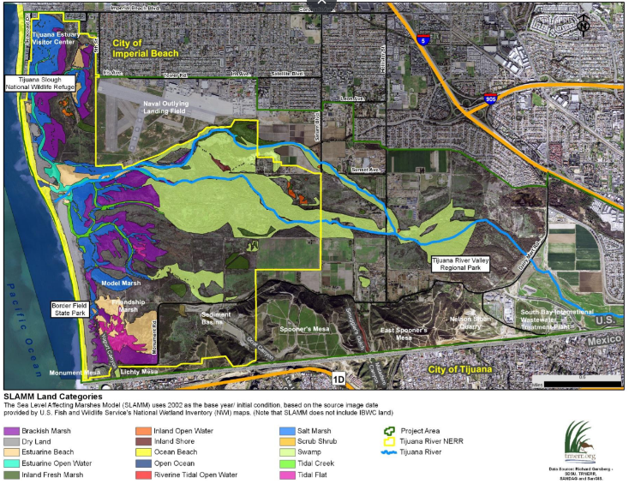
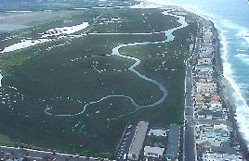
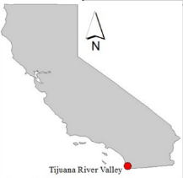
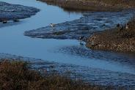
Tijuana National Estuarine Research Reserve
SLR
Delft3D (Sed Transport)
Marsh Vulnerability to SLR
Photos: Visit Imperial Beach/H Joseph F | Map: TNNER
Notes:
Tijuana River national estuarine research reserve sits on the US Mexico border.
Home to over 370 species of birds, including the largest population of the endangered light-footed Ridgway’s rail.
Also contains significant amounts of wetland habitat
Mouth of the Tijuana River, which has 75% of it’s watershed in Mexico.
Also the recipient to sub-tributaries which lie entirely within Mexico such as Los Laureles canyon.

Slide 3
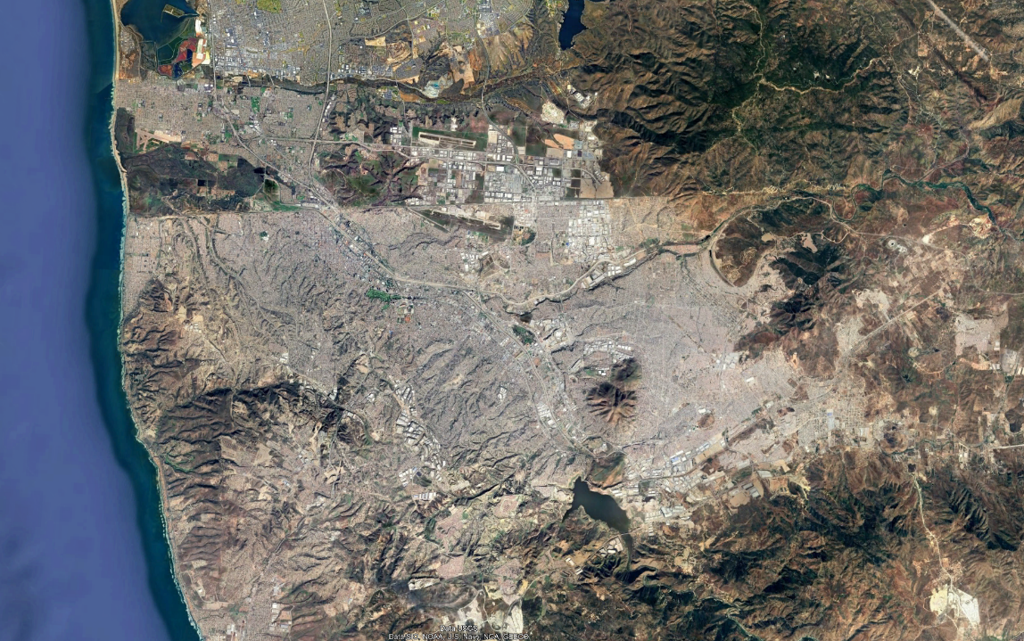
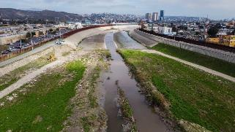

People
Money
Goods
Tijuana River Estuary
Water
Sewage
Sediment
Trash
US-Mexico Border
Tijuana River Mainstem + Tributaries
Los Laureles Canyon Tributary

Slide 4
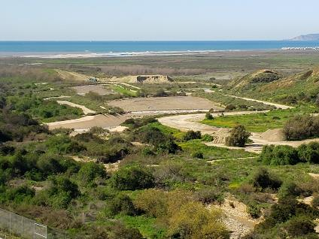
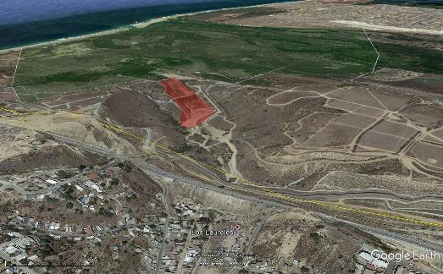
Tijuana National Estuarine Research Reserve
wetlands
sed-basins
Photos: Visit Imperial Beach/H Joseph F | Map: TNNER
Notes:
Tijuana River national estuarine research reserve sits on the US Mexico border.
Home to over 370 species of birds, including the largest population of the endangered light-footed Ridgway’s rail.
Also contains significant amounts of wetland habitat
Mouth of the Tijuana River, which has 75% of it’s watershed in Mexico.
Also the recipient to sub-tributaries which lie entirely within Mexico such as Los Laureles canyon.

Slide 5
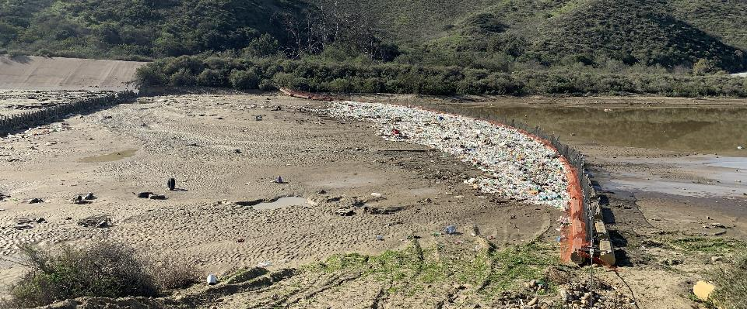
Plastic and Sediment Management Challenges at Tijuana National Estuarine Research Reserve
$1-2 million/year
to CA State Parks
Photo: Southwest Wetlands Interpretive Association
Notes:
“If they don’t act now there won’t be wetlands to save from SLR”
Wetland loss at the Tijuana River National Estuarine Research Reserve from Los Laureles canyon runoff.
Substantial losses due to excess watershed sediment loads
Erosion
Hillslope failure
Infrastructure failures
Als

Slide 6
Funding Challenges
The Tijuana River Estuary is emblematic the many funding challenges experienced by environmental managers worldwide

Slide 7
Funding Challenges
The Tijuana River Estuary is emblematic the many funding challenges experienced by environmental managers worldwide
Lack of large-scale volumes of capital to affect change

Slide 8
Funding Challenges
The Tijuana River Estuary is emblematic the many funding challenges experienced by environmental managers worldwide
Lack of large-scale volumes of capital to affect change
Jurisdictional issues preventing capital movement

Slide 9
Funding Challenges
The Tijuana River Estuary is emblematic the many funding challenges experienced by environmental managers worldwide
Lack of large-scale volumes of capital to affect change
Jurisdictional issues preventing capital movement
Disperse, and variable benefits dependent on stochastic processes

Slide 10
Funding Challenges
The Tijuana River Estuary is emblematic the many funding challenges experienced by environmental managers worldwide
Hundreds of billions of dollars a year are needed for environmental conservation, but this cannot be met by the traditional government and philanthropic funding sources alone
Notes:
Contemporary estimates suggest that globally, $722 to $967 billion is needed annually
Current allocation of $124 billion a year

Slide 11
Funding Challenges
The Tijuana River Estuary is emblematic the many funding challenges experienced by environmental managers worldwide
Hundreds of billions of dollars a year are needed for environmental conservation, but this cannot be met by the traditional government and philanthropic funding sources alone
Environmental Impact Bonds are one way to meet this financing gap and bring in private sources of capital to solve environmental issues

Slide 12
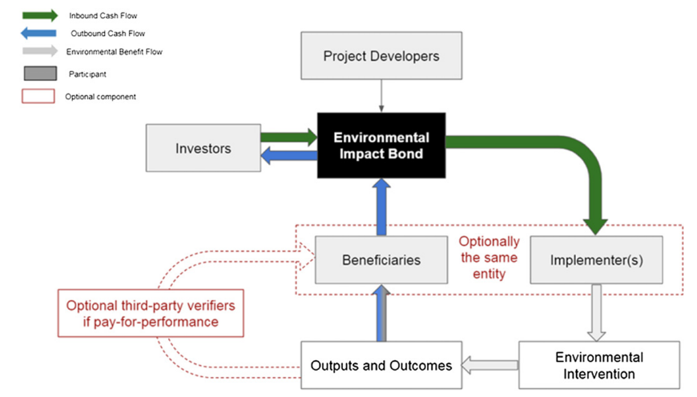
Environmental Impact Bonds
Notes:
EIBs are a financing mechanism to raise capital for environmental projects which repay the principal and interest
using financial benefits stemming from the ecosystem co-benefits.
EIBs are structured similarly to traditional bonds where principal is borrowed by stakeholders/beneficiaries with the promise of repayment
to investors, with interest, over time.
However, the main difference between EIBs and traditional bonds is that traditional bonds are often repaid with general revenues from the issuer, not necessarily related to the financing activity
Whereas EIBs specifically tie financial return on investment to the success of the intervention and revenue generated and/or cost savings related to that success

Slide 13

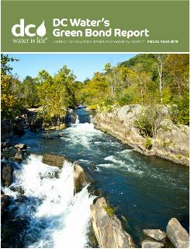
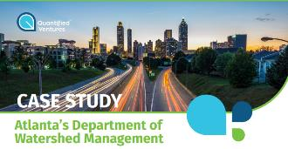
Examples of Environmental Impact Bonds
$18 million
$6.7 million
$25 million
Notes:
FRB – Wildfires, DC Water Bond – Water Quality, CSO reduction, Atlanta – Flooding reduction

Slide 14
Environmental Impact Bonds
Benefits
Provide one financial vehicle for multiple beneficiaries/stakeholders to rally around and serve as an unbiased intermediary
Allow stakeholders and beneficiaries to quickly raise large volumes of up-front capital to realize more immediate environmental benefits
Provide opportunities to aggregate projects and/or funds

Slide 15
Motivation
What are the major challenges for widespread acceptance of EIB’s?
“…accountability of payments…” (Balboa, 2016)

Slide 16
Motivation
What are the major challenges for widespread acceptance of EIB’s?
“…accountability of payments…” (Balboa, 2016)
… “establishing direct links between an intervention and outcome (Jackson, 2013), and

Slide 17
Motivation
What are the major challenges for widespread acceptance of EIB’s?
“…accountability of payments…” (Balboa, 2016)
… “establishing direct links between an intervention and outcome (Jackson, 2013), and
rigorously connecting the risk and associated return with each EIB” (Brandsetter and Lehner, 2015).

Slide 18
Motivation
What are the major challenges for widespread acceptance of EIB’s?
“…accountability of payments…” (Balboa, 2016)
… “establishing direct links between an intervention and outcome (Jackson, 2013), and
rigorously connecting the risk and associated return with each EIB” (Brandsetter and Lehner, 2015).
Monte Carlo modeling has a long and established history in environmental and financial modeling (Korn et al., 2010; Glasserman, 2013), but, relatively few, if any studies have coupled Monte Carlo environmental and financial models to develop an EIB.

Slide 19

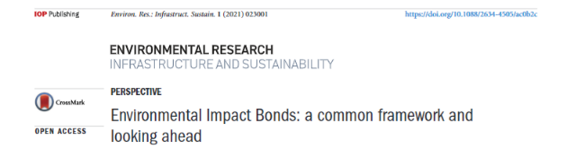
Motivation
What are the major challenges for widespread acceptance of EIB’s?
“…accountability of payments…” (Balboa, 2016)
… “establishing direct links between an intervention and outcome (Jackson, 2013), and
rigorously connecting the risk and associated return with each EIB” (Brandsetter and Lehner, 2015).
Monte Carlo modeling has a long and established history in environmental and financial modeling (Korn et al., 2010; Glasserman, 2013), but, relatively few, if any studies have coupled Monte Carlo environmental and financial models to develop an EIB.

Slide 20
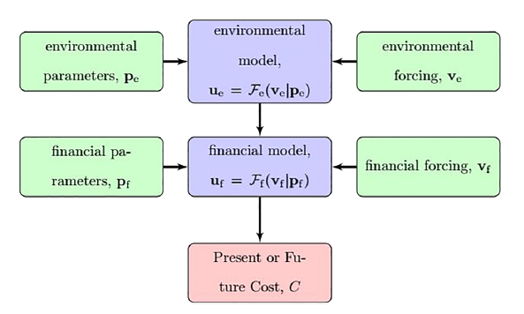


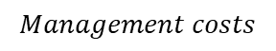
Model Overview
vegetation types, hydrodynamic roughness, elevation
rainfall, streamflow, oceanic forcing
Inflation, cost of financing
Flood levels, sediment yields, nutrient loads
Intervention costs, good/service prices
Damages, management costs
$$pdf$$
$$Management costs$$
Brand, M. W., Gudiño‐Elizondo, N., Allaire, M., Wright, S., Matson, W., Saksa, P., & Sanders, B. F. (2020). Stochastic hydro‐financial watershed modeling for Environmental Impact Bonds. Water Resources Research, 56(8), e2020WR027328.
Notes:
A series of monte carlo (or monte carlo Markov chain) models which take as inputs environmental parameters (such as vegetation types, hydrodynamic roughness, elevation) and forcings (such as rainfall, streamflow, oceanic forcing) and make predictions of key environmental state variable outputs. Examples of outcomes include flood extent, sediment, water, or trash yields, or contaminants.
These environmental state variable outputs are used to make estimates of financial outcomes, namely through management costs or damages through the financial model. The financial model uses both financial forcing and parameters. Examples include things like interest rates, cost of interventions, and variability in goods/service prices.

Slide 21
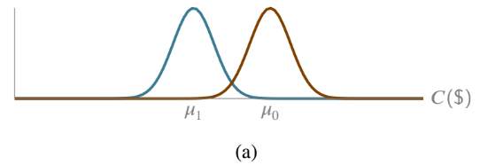

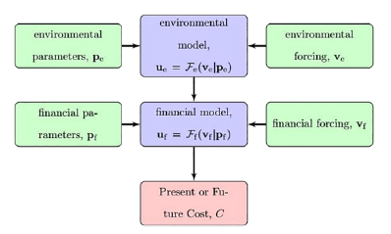
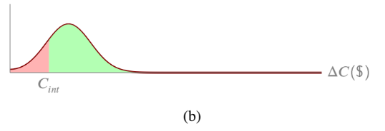
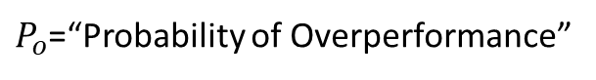
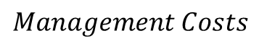
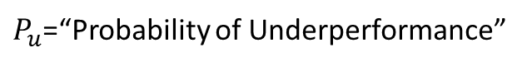
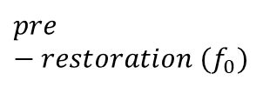
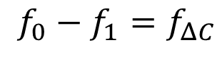
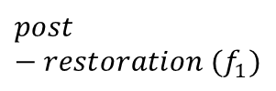
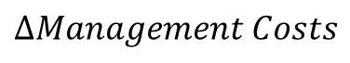
Model Overview
$$post−restoration (f_{1})$$
$$pre−restoration (f_{0})$$
$$Management Costs$$
$$f_{0}−f_{1}=f_{ΔC}$$
$P_{o}$=“Probability of Overperformance”
$$ΔManagement Costs$$
$P_{u}$=“Probability of Underperformance”
Brand, M. W., Gudiño‐Elizondo, N., Allaire, M., Wright, S., Matson, W., Saksa, P., & Sanders, B. F. (2020). Stochastic hydro‐financial watershed modeling for Environmental Impact Bonds. Water Resources Research, 56(8), e2020WR027328.
Notes:
We run the model many times to characterize uncertainty in management costs. This yields a pdf of costs which we’ll call f0. Then, we modify different environmental and financial model parameters and forcings to simulate interventions.
These interventions could include things such as wetland restoration reduce flooding, raingardens to improve water quality, or forest restoration to reduce the likelihood and impact of wildfires.
This yields a reduced management cost or risk, shown in blue. The difference between these two is another pdf of cost savings, shown here on the bottom. If we plot the cost of the intervention on the cost savings pdf, the area to the right of the curve in green is the probability that cost savings exceed the cost of the intervention. If we integrate the area to the left of the curve, that is the probability that our intervention costs more than the accumulated savings.
This information can help stakeholders and investors identify interventions that are most likely to succeed ahead of time, increasing investor confidence and increasing the likelihood of funding. It also can be a helpful tool to identify key uncertainties in the EIB structure and identify areas which would benefit from further research.

Slide 22
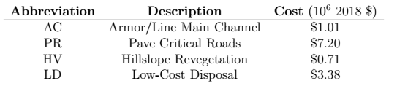
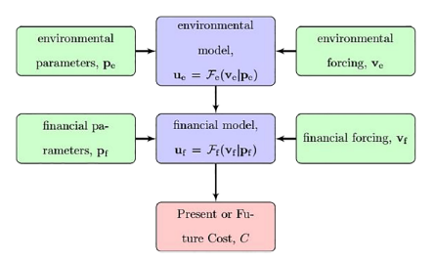
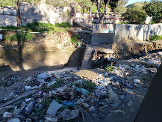
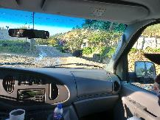
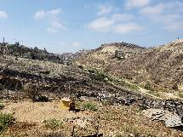
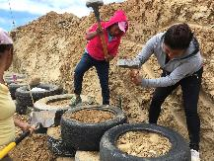
Modeled Interventions
AC
PR
HV
LD
Brand, M. W., Gudiño‐Elizondo, N., Allaire, M., Wright, S., Matson, W., Saksa, P., & Sanders, B. F. (2020). Stochastic hydro‐financial watershed modeling for Environmental Impact Bonds. Water Resources Research, 56(8), e2020WR027328.

Slide 23
Modeled Interventions
AC
PR
HV
LD
Brand, M. W., Gudiño‐Elizondo, N., Allaire, M., Wright, S., Matson, W., Saksa, P., & Sanders, B. F. (2020). Stochastic hydro‐financial watershed modeling for Environmental Impact Bonds. Water Resources Research, 56(8), e2020WR027328.

Slide 24
Modeled Interventions
AC
PR
HV
LD
Brand, M. W., Gudiño‐Elizondo, N., Allaire, M., Wright, S., Matson, W., Saksa, P., & Sanders, B. F. (2020). Stochastic hydro‐financial watershed modeling for Environmental Impact Bonds. Water Resources Research, 56(8), e2020WR027328.

Slide 25
Modeled Interventions
AC
PR
HV
LD
Brand, M. W., Gudiño‐Elizondo, N., Allaire, M., Wright, S., Matson, W., Saksa, P., & Sanders, B. F. (2020). Stochastic hydro‐financial watershed modeling for Environmental Impact Bonds. Water Resources Research, 56(8), e2020WR027328.

Slide 26
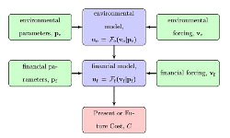
Stochastic EnvironmentAl Model- environmental impact Bond (SEAM-B)
Pre-Intervention
rainfall
sediment generation
rainfall
sediment to basin
year
Brand, M. W., Gudiño‐Elizondo, N., Allaire, M., Wright, S., Matson, W., Saksa, P., & Sanders, B. F. (2020). Stochastic hydro‐financial watershed modeling for Environmental Impact Bonds. Water Resources Research, 56(8), e2020WR027328.

Slide 27
Stochastic EnvironmentAl Model- environmental impact Bond (SEAM-B)
Pre-Intervention
rainfall
sediment generation
sediment to basin
rainfall
$$$
year
Brand, M. W., Gudiño‐Elizondo, N., Allaire, M., Wright, S., Matson, W., Saksa, P., & Sanders, B. F. (2020). Stochastic hydro‐financial watershed modeling for Environmental Impact Bonds. Water Resources Research, 56(8), e2020WR027328.

Slide 28
Stochastic EnvironmentAl Model- environmental impact Bond (SEAM-B)
Post-Intervention
rainfall
sediment generation
sediment to basin
rainfall
Cost Savings (C_{i})
$$$
year
Brand, M. W., Gudiño‐Elizondo, N., Allaire, M., Wright, S., Matson, W., Saksa, P., & Sanders, B. F. (2020). Stochastic hydro‐financial watershed modeling for Environmental Impact Bonds. Water Resources Research, 56(8), e2020WR027328.

Slide 29
Stochastic EnvironmentAl Model- environmental impact Bond (SEAM-B)
Post-Intervention
Just one realization of an infinite number of possibilities
Quantify variability of future cash flows using MCMC sampling of different rainfall, interest rate, and sediment contamination forcings (thousand of simulations)
rainfall
Cash Flow
(+)
cash flow from cost savings
sediment generation
sediment to basin
rainfall
Cost Savings (C_{i})
(-)
$$$
initial outlay to fund infrastructure
year
Brand, M. W., Gudiño‐Elizondo, N., Allaire, M., Wright, S., Matson, W., Saksa, P., & Sanders, B. F. (2020). Stochastic hydro‐financial watershed modeling for Environmental Impact Bonds. Water Resources Research, 56(8), e2020WR027328.

Slide 30
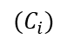
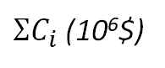
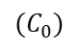
P_{o}
Cash Flow
cash flow from cost savings
(+)
$$(C_{i})$$
Probability of Occurrence
t
Run 10,000+ times to quantify uncertainty
(-)
5
10
15
20
$ΣC_{i}$ (10⁶$)
$$(C_{0})$$
C₀
P_{u}
Brand, M. W., Gudiño‐Elizondo, N., Allaire, M., Wright, S., Matson, W., Saksa, P., & Sanders, B. F. (2020). Stochastic hydro‐financial watershed modeling for Environmental Impact Bonds. Water Resources Research, 56(8), e2020WR027328.
Notes:
Simplify – histogram of possible outcomes, what fraction of outcomes have total cash flow less than the initial capital outlay (C0), gives you Ploss, while if you look at the fraction of realizations where the sum of cost savings exceed the initial outlay, it gives you Pprofit.

Slide 31
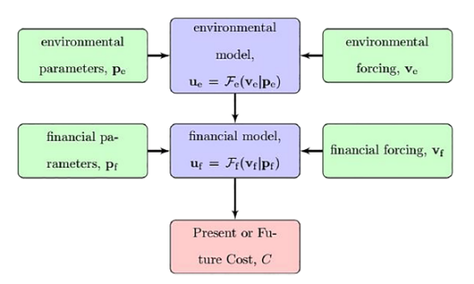
Results and Conclusions
Probability of Under/Overperformance for Each Intervention
Intervention | P_{u} | P_{o}
Armor Channel | 0% | 100%
Pave Critical Roads | 82% | 18%
Hillslope Revegetation | 58% | 42%
Local-Low Cost Disposal | 6% | 94%
All Interventions | 41% | 59%
Sediment management upstream yields significant savings downstream, which repay for themselves
The financial model is a tool to facilitate cross-border collaboration
Model did not include potentially significant environmental co-benefits
Improved wetland health, reduced plastics loading, enhanced tourism revenue
Brand, M. W., Gudiño‐Elizondo, N., Allaire, M., Wright, S., Matson, W., Saksa, P., & Sanders, B. F. (2020). Stochastic hydro‐financial watershed modeling for Environmental Impact Bonds. Water Resources Research, 56(8), e2020WR027328.

Slide 32
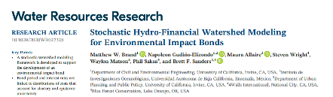



Results and Conclusions
Patagonia Funded Docuseries on the “Border Impact Bond”
Brand, M. W., Gudiño‐Elizondo, N., Allaire, M., Wright, S., Matson, W., Saksa, P., & Sanders, B. F. (2020). Stochastic hydro‐financial watershed modeling for Environmental Impact Bonds. Water Resources Research, 56(8), e2020WR027328.

Slide 33
Future Applications
Reducing coupled fire-flood debris flow risks in Riverside County
Can targeted interventions in reducing fire risk pay for themselves with reduced debris basin maintenance costs?
Site: Cleveland National Forest, Riverside County
A cost-benefit analysis of wetland restoration for sea-level rise adaptation in the Pacific Northwest, incorporating externalities and ecosystem co-benefits
Funded by NOAA-ESLR Technical Assistance Program
Can we pay for wetland restoration using the flood reduction, CO₂ sequestration, and salmon habitat benefits?

Slide 34
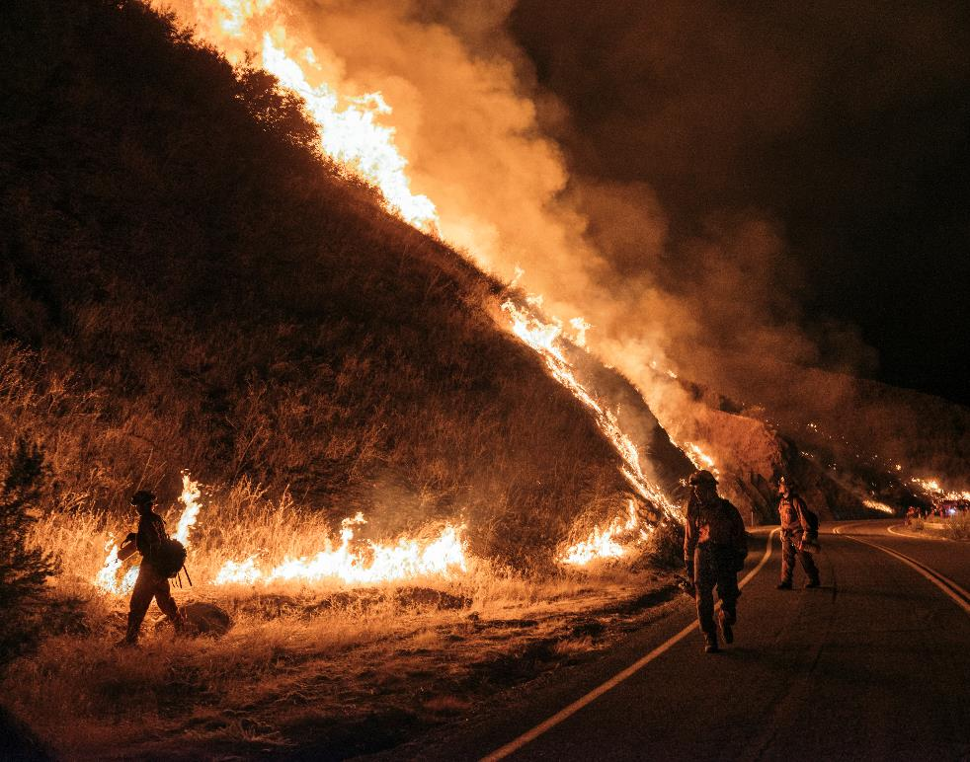
Future Applications
Reducing coupled fire-flood debris flow risks in Riverside County
Can targeted interventions in reducing fire risk pay for themselves with reduced debris basin maintenance costs?
Site: Cleveland National Forest, Riverside County
A cost-benefit analysis of wetland restoration for sea-level rise adaptation in the Pacific Northwest, incorporating externalities and ecosystem co-benefits
Funded by NOAA-ESLR Technical Assistance Program
Can we pay for wetland restoration using the flood reduction, CO₂ sequestration, and salmon habitat benefits?

Slide 35
















Reducing coupled fire-flood debris flow risks in California
Debris Basin
Precipitation
Bulked flow (water + coarse sediment)
Burned Area
Fire/Mud/Debris Hazard Zone
Mountain Wildland
Flood Hazard Zone
Development Break
Wildland Urban Interface
Flood Channel
Topographic Break
Urbanized Lowland
Ariane Jong-Levinger (2023)
Jong‐Levinger, A., Banerjee, T., Houston, D., & Sanders, B. F. (2022). Compound post‐fire flood hazards considering infrastructure sedimentation. Earth's Future, 10(8), e2022EF002670.
Notes:
- conceptual diagram of role of infrastructure in development of post-fire floods
- debris basin situated at mouth of watershed designed to capture sediment and debris & only allow water to flow into flood channel
- flood channel conveys clear-water flow safely past community to downstream water body
- if a sequence of storms occurs after the watershed burns, sediment fills the debris basin over time and if the debris basin overflows, a mixture of water and sediment enters the flood channel – called bulked flow
- channel not designed to convey bulked flow and clogs, leading to increased likelihood of flooding

Slide 36

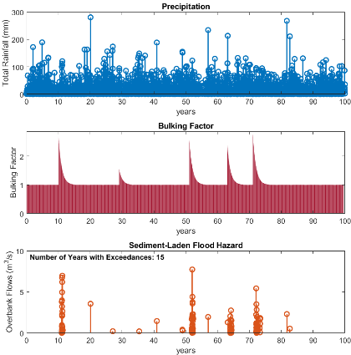
Reducing coupled fire-flood debris flow risks in California
Introduction
Model Formulation
Methods
Results
Conclusion
Infrastructure Design Capacity
Sizing of debris basin and flood channel based on storm size and design standard
Storm Size: 50-year or 100-year design storm
Design Standard: Clear-water or Bulked
Infrastructure Maintenance Approaches
Based on communication with Riverside County Flood Control
Summer Cleaning Only
Summer + After-fire
Summer + After-fire + Wet Season
Model Demonstration
Year 10: relatively dry year, yet watershed burned → many channel exceedances
Year 20: wettest year on record, yet no fire → only one channel exceedance
Given the importance of fire on flood risk, can the cost of fire risk reduction be paid for by both the reduction in maintenance costs and flood risks?
Ariane Jong-Levinger (2023)
Jong‐Levinger, A., Banerjee, T., Houston, D., & Sanders, B. F. (2022). Compound post‐fire flood hazards considering infrastructure sedimentation. Earth's Future, 10(8), e2022EF002670.
Notes:
Infrastructure size depends on return level of design storm and type of design standard: both based on current design standards in Southern California
Maintenance approaches modeled after maintenance protocols of Riverside County, implemented using rules-based equations with respect to cleaning timing and rates
Figure on right shows how model captures interactions between storms, wildfires, & infrastructure
First consider storm during year 10…
Now consider storm during year 20…
[Scenario:
50B (design k = 1.2)
Summer Cleaning
20 yr fire interval
Area = 3 sq. km]

Slide 37
Future Applications
Reducing coupled fire-flood debris flow risks in Riverside County
Can targeted interventions in reducing fire risk pay for themselves with reduced debris basin maintenance costs?
Site: Cleveland National Forest, Riverside County
A cost-benefit analysis of wetland restoration for sea-level rise adaptation in the Pacific Northwest, incorporating externalities and ecosystem co-benefits
Funded by NOAA-ESLR Technical Assistance Program
Can we pay for wetland restoration using the flood reduction, CO₂ sequestration, and salmon habitat benefits?

Slide 38
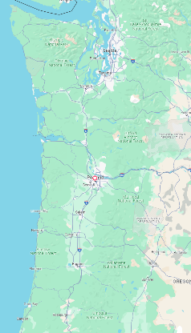
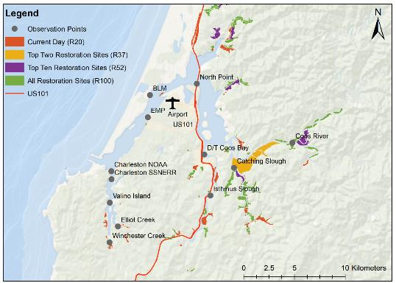
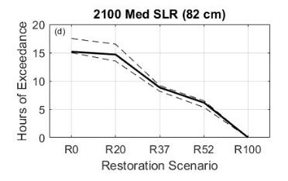
Quantifying Flood Risk Reduction Benefits of Wetland Restoration: Coos Bay, Oregon
Brand, M. W., Diefenderfer, H.L., Cornu, C., McKeon, M., Janousek, C., Borde, A.B., Souza, T., Keogh, M., Brown, C.A., and Bridgham, S. (2024) Can restoring tidal wetlands reduce nuisance flooding of coasts under future sea-level rise? Under Review: Earth's Future
Notes:
Questions:
How is future nuisance flooding impacted by wetland restoration?
Q: Who can tell me what nuisance flooding is?
A: Nuisance flooding is flooding that occurs on a regular basis and blocks streets, backs up sewage and storm drain systems, and causes disruptions. Oftentimes defined as depths >3cm and <10 cm
We look exclusively at “sunny day flooding” so flooding which would occur due to astronomic tidal forces and are nearly perfectly predictable

Slide 39
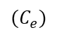
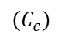
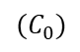
Broader Research Interests
How can we include other co-benefits in EIBs to expand revenue streams?
Cash Flow
$$(C_{e})$$
eco-tourism
$$(C_{c})$$
carbon sequestration
(+)
$$(C_{i})$$
cost savings
t
(-)
$$(C_{0})$$
Notes:
Environmental memory: even if we were to shut down all the excess nitrogen to the MI River today, it would take decades for that effect to be noticed at the Gulf of Mexico dead zone
Low P extreme events: given the likelihood of a 100-year storm is only 1%/year, how do we measure its success in a 10-year bond?

Slide 40
Broader Research Interests
How can we include other co-benefits in EIBs to expand revenue streams?
What is the interplay between environmental and credit risk?
e.g. major wildfire both negatively impacts environmental quality + credit rating of landowner through infrastructure damage
Notes:
Environmental memory: even if we were to shut down all the excess nitrogen to the MI River today, it would take decades for that effect to be noticed at the Gulf of Mexico dead zone
Low P extreme events: given the likelihood of a 100-year storm is only 1%/year, how do we measure its success in a 10-year bond?

Slide 41
Broader Research Interests
How can we include other co-benefits in EIBs to expand revenue streams?
What is the interplay between environmental and credit risk?
e.g. major wildfire both negatively impacts environmental quality + credit rating of landowner through infrastructure damage
Does accelerated environmental restoration through EIBs result in enhanced environmental outcomes compared to oftentimes piecemeal, grant based financing for restoration?
Notes:
Environmental memory: even if we were to shut down all the excess nitrogen to the MI River today, it would take decades for that effect to be noticed at the Gulf of Mexico dead zone
Low P extreme events: given the likelihood of a 100-year storm is only 1%/year, how do we measure its success in a 10-year bond?

Slide 42
Broader Research Interests
How can we include other co-benefits in EIBs to expand revenue streams?
What is the interplay between environmental and credit risk?
e.g. major wildfire both negatively impacts environmental quality + credit rating of landowner through infrastructure damage
Does accelerated environmental restoration through EIBs result in enhanced environmental outcomes compared to oftentimes piecemeal, grant based financing for restoration?
Are there locations or restoration opportunities in Louisiana and/or the Gulf Region that would be good sites for testing an EIB?
Notes:
Environmental memory: even if we were to shut down all the excess nitrogen to the MI River today, it would take decades for that effect to be noticed at the Gulf of Mexico dead zone
Low P extreme events: given the likelihood of a 100-year storm is only 1%/year, how do we measure its success in a 10-year bond?

Slide 43

I’m Hiring!
Postdoctoral Researcher to quantify ecosystem co-benefits of wetland restoration in the Pacific Northwest and beyond
Also open to motivated MS and PhD students who want to study:
Ecosystem co-benefits of wetland restoration activates
Environmental economics/finance
Flood risk reduction due to green infrastructure using hydrodynamic modeling
Dr. Matthew Brand
mbrand@lsu.edu

Slide 44
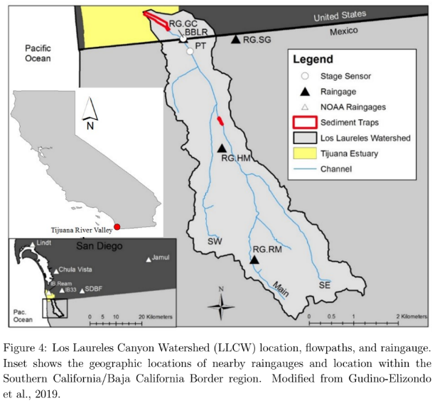
US-MEX Border
wetlands
sed-basins
Notes:
Solution to wetland loss has been sedimentation basins

Slide 45
US-MEX Border
sed-basins
Notes:
Upstream sediment management is key
However, these interventions cost significant volumes of capital
CA State Parks and the Research Reserve don’t have upfront capital to fund interventions
Border acts as an impediment for capital movement

Slide 46
Model Overview
Temperature, Rainfall
Hillslope vegetation, slope
Disposal costs / plastics deposition
Basin management costs
Inflation rate
Model allows for us to calculate intervention effectiveness under environmental (rainfall, channel erosion) and financial (disposal costs, inflation) uncertainties by modifying both forcings and parameters
Brand, M. W., Gudiño‐Elizondo, N., Allaire, M., Wright, S., Matson, W., Saksa, P., & Sanders, B. F. (2020). Stochastic hydro‐financial watershed modeling for Environmental Impact Bonds. Water Resources Research, 56(8), e2020WR027328.

